Slide 1
Chemistry for biologists
Quiz review

Slide 2
1. Copy the following table on your white board and complete it. For atomic mass, simply round up to the nearest whole number.
Name of element | Symbol | Number of protons | Number of neutrons | Atomic mass
Neon |  |  |  | 20
 | Cl | 17
 |  | 28 | 31
 |  |  |  | 52
 |  |  | 110

Slide 3
Answer
Name of element | Symbol | Number of protons | Number of neutrons | Atomic mass
Neon | Ne | 10 | 10 | 20
Chlorine | Cl | 17 | 18 | 35
Nickel | Ni | 28 | 31 | 59
Chromium | Cr | 24 | 28 | 52
Tungsten | W | 74 | 110 | 184

Slide 4
Please name and indicate the number of subatomic particles for each of the following Radioisotopes:
Radioisotope | Protons | Neutrons | Electrons
⁴⁷Ca

Slide 5
Answer
Radioisotope | Protons | Neutrons | Electrons
⁴⁷Ca | 20 | 27 | 20

Slide 6
Please name and indicate the number of subatomic particles for each of the following Radioisotopes:
Radioisotope | Protons | Neutrons | Electrons
¹⁴C

Slide 7
Answer
Radioisotope | Protons | Neutrons | Electrons
¹⁴C | 6 | 8 | 6

Slide 8
Please name and indicate the number of subatomic particles for each of the following Radioisotopes:
Radioisotope | Protons | Neutrons | Electrons
⁶⁰Co

Slide 9
Answer
Radioisotope | Protons | Neutrons | Electrons
⁶⁰Co | 27 | 33 | 27

Slide 10
Please name and indicate the number of subatomic particles for each of the following Radioisotopes:
¹³¹I
Radioisotope | Protons | Neutrons | Electrons
¹³¹I

Slide 11
Answer
¹³¹I
Radioisotope | Protons | Neutrons | Electrons
¹³¹I | 53 | 78 | 53

Slide 12
Please name and indicate the number of subatomic particles for each of the following Radioisotopes:
¹³¹I
Radioisotope | Protons | Neutrons | Electrons
⁶⁷Cu

Slide 13
Answer
¹³¹I
Radioisotope | Protons | Neutrons | Electrons
⁶⁷Cu | 29 | 38 | 29

Slide 14
An atom has 8 protons, draw an electron shell model for this atom. How many unpaired electrons does this element have? What is the name of this element?

Slide 15
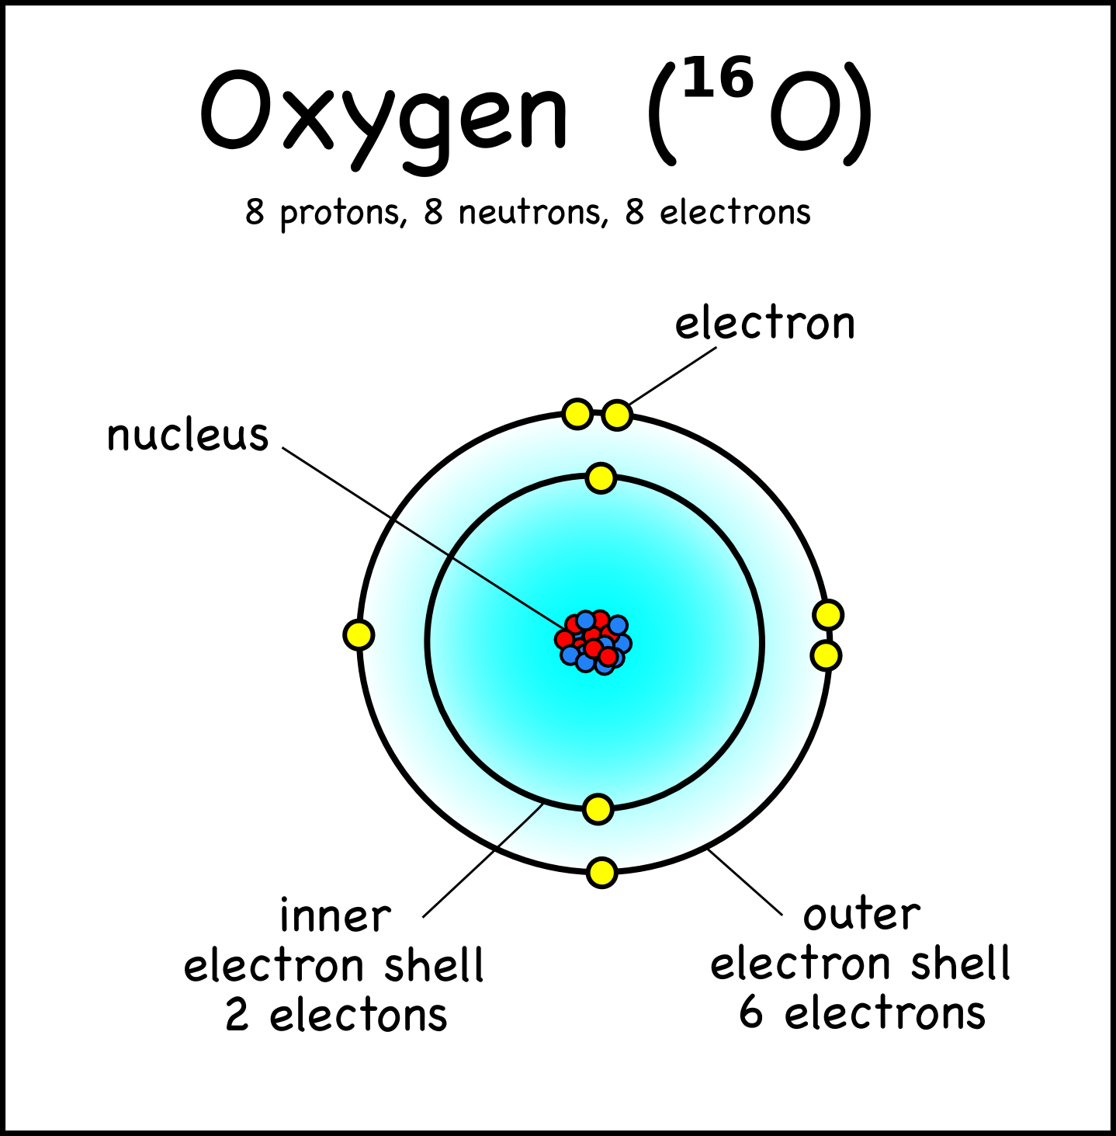
Answer
2 unpaired electrons

Slide 16
Draw a Lewis diagram for the following element
Element | Lewis Diagram
Phosphorus

Slide 17
Answer
Element | Lewis Diagram
Phosphorus

Slide 18
Draw a Lewis diagram for the following element
Element | Lewis Diagram
Carbon

Slide 19
Answer
Element | Lewis Diagram
Carbon

Slide 20
Draw a Lewis diagram for the following Molecule
Element | Lewis Diagram
Water

Slide 21
Answer
Element | Lewis Diagram
Water

Slide 22
4) How do polar covalent bonds and non-polar covalent bonds differ?

Slide 23
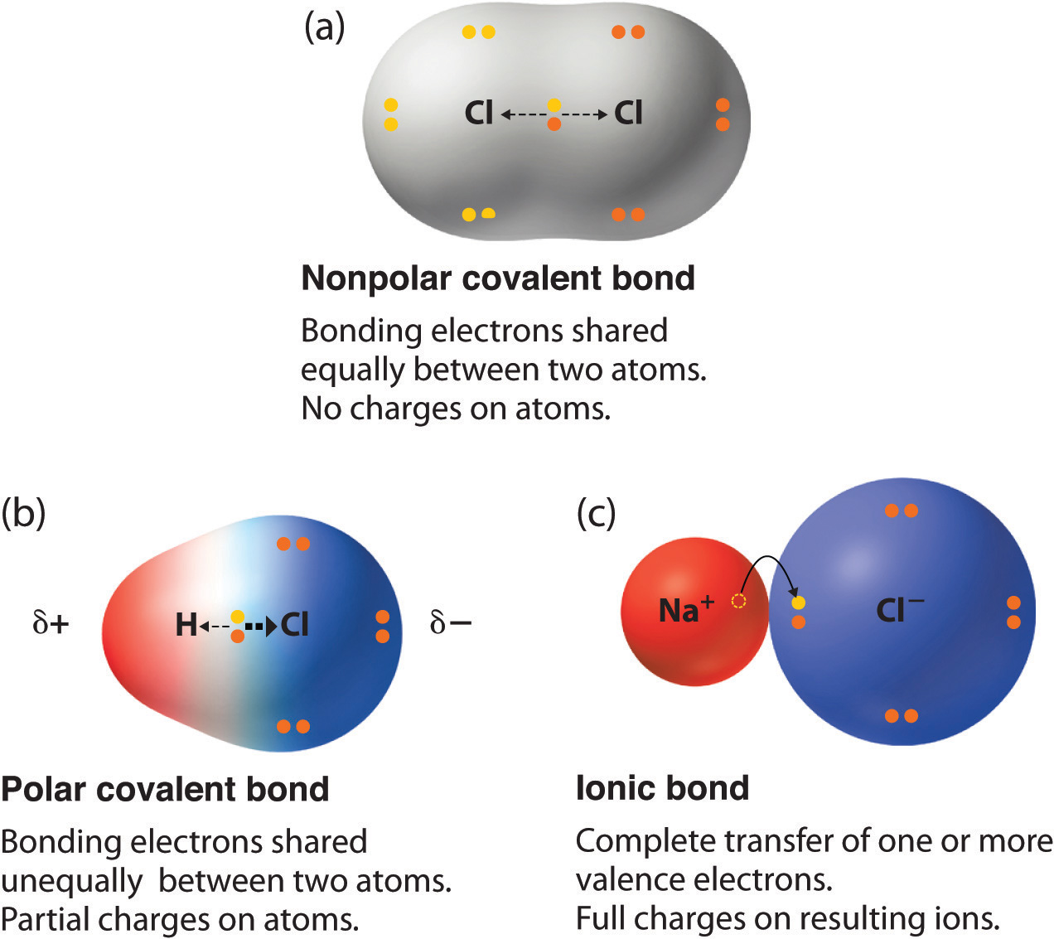
Answer
No significant difference in electronegativity
Significant difference in electronegativity (between 0.5 and 1.7)

Slide 24
In a bond between nitrogen and hydrogen (N - H), which atom will the electrons closer to? Explain you reasoning.

Slide 25
Answer
The electronegativity of Nitrogen is 3.0 while the electronegativity of Hydrogen is 2.1. In other words, Nitrogen has more “pull” on the shared electrons and they will closer to N than H
Because of this, Nitrogen becomes slightly negative and hydrogen become slightly positive

Slide 26
What are the main differences between ionic bonds and covalent bonds?

Slide 27
Answer
 | Ionic Bonding | Covalent Bonding
Between | Metal and non-Metal | Two or more non-metals
Mechanism | TOTAL TRANSFER OF ELECTRONS Metal loses e CATION Non-metal Gains e ANION | Valence electrons are shared (up to four shared pairs)
Difference in Electronegativity | Greater than 1.7 | Polar – between 0.5 and 1.7 / Non-polar less than 0.5
Strength of bonds | Strong Bonds | Weak Bonds
Water solubility | Soluble in water | Insoluble in water
Structure | Crystal Lattice | Individual molecules. Structures vary greatly depending on how individual molecules interact with each other. Depends mostly on: polarity, size and 3D shape

Slide 28
Water is a polar molecule. Explain how the polarity of water accounts for its lattice structure.

Slide 29
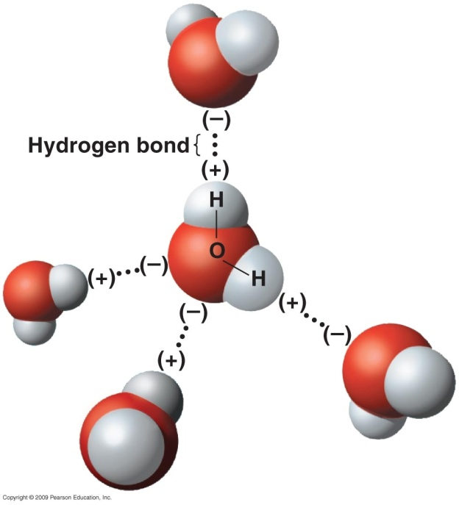
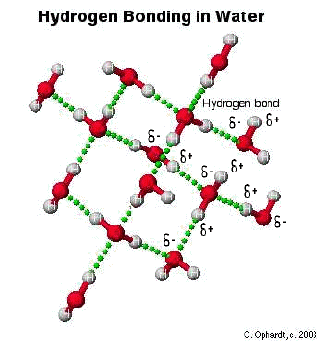
Answer
The polarity of water helps the formation of hydrogen bonds among water molecules. Hydrogen bonds creates the lattice structure of water.

Slide 30
Potassium chloride, KBr is an ionic compound. Describe what happens to its ions when it is dissolved in water.

Slide 31
Answer
When potassium bromide, KBr, is dissolved in water it dissociates into potassium ions, K+ , and bromine ions, Br– ions. These ions are enveloped by water molecules (due to water’s polarity) to form a surface coat also called hydration shell.
***Picture on next slide

Slide 32
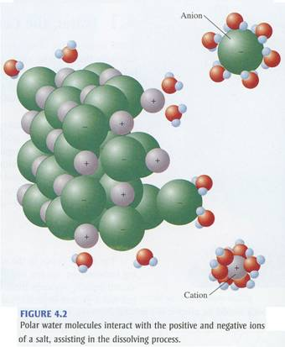

Slide 33
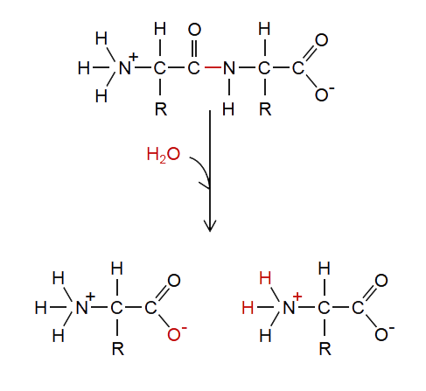
Name this type of reaction

Slide 34
Answer
Hydrolysis!
Notice the addition of water will break the bond, and create 2 products

Slide 35
What are the products of this reaction?
HNO3 + NaOH
(Acid)
(Base)

Slide 36
Answer
HNO₃ + NaOH H₂O + NaNO₃
(Acid)
(Base)
(Water)
(Salt)

Slide 37
How do acids and bases differ in terms of how they behave when added to pure water

Slide 38
Answer
Acids when placed in aqueous solution cause the production of hydronium ions, increasing Proton (H+) concentration and lowering the pH.
Bases cause the production of hydroxide ions in aqueous solution, increasing OH– concentration, and raising the pH.

Slide 39
What is a hydrocarbon. Are these types of molecules polar?

Slide 40
Answer
Molecules consisting of only carbon atoms bonded to hydrogen atoms are called hydrocarbons.
These are non-polar molecules due to the insignificant ( less than 0.5) difference in electronegativity. Non polar molecules (no charge) are considerer hydrophobic (not strongly attracted to water)

Slide 41
Identify the functional group in each of the molecules by circling and naming each
Molecule | Name | Found in

Slide 42
Answer
Molecule | Name | Found in
 | Hydroxyl | Alcohols and Carbohydrates

Slide 43
Identify the functional group in each of the molecules by circling and naming each
Molecule | Name | Found in

Slide 44
Answer
Molecule | Name | Found in
 | Carbonyl (Aldehyde) | Carbohydrates

Slide 45
Identify the functional group in each of the molecules by circling and naming each
Molecule | Name | Found in

Slide 46
Answer
Molecule | Name | Found in
 | Carboxyl | Amino Acids and Fatty Acids (lipids)

Slide 47
Identify the functional group in each of the molecules by circling and naming each
Molecule | Name | Found in

Slide 48
Answer
Molecule | Name | Found in
 | Carbonyl (Ketone) | Carbohydrates

Slide 49
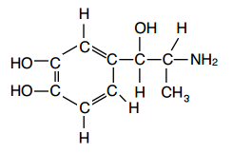
Identify the functional group in each of the molecules by circling and naming each
Molecule | Name | Found in

Slide 50
Answer
Molecule | Name | Found in
 | Hydroxyl | Alcohols and Carbohydrates
 | Amino | Amino Acids, Proteins

