Slide 1
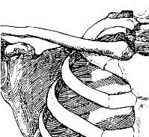
The Skeletal System
Clavicle
The Shoulder (Pectoral) Girdle
The bones of the pectoral girdle
are the:
Scapula (Shoulder Blade)
Clavicle (Collar Bone)
Scapula

Slide 2
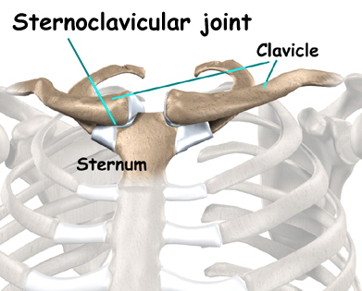
The Shoulder (Pectoral Girdle)
The Shoulder girdles allow the upper limb great mobility.
The sternoclavicular joint between the sternum and the clavicle is the only bony joint between the axial skeleton and the shoulder girdle

Slide 3
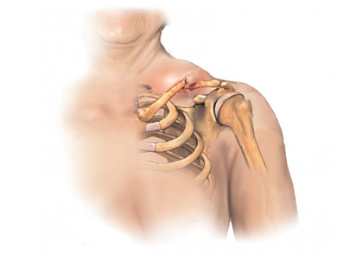
The Shoulder (Pectoral Girdle)
A fracture of the clavicle is very common during falls of collisions during sporting activities.

Slide 4
The Upper Limb
The Humerus
The arm bone
Shoulder to elbow
The Radius and Ulna
From the elbow to the wrist,
These two bones make up the forearm.
The radius is located on the thumb
side of the hand.
When pronating the forearm, the radius
crosses over the ulna
Humerus
Radius
Ulna

Slide 5
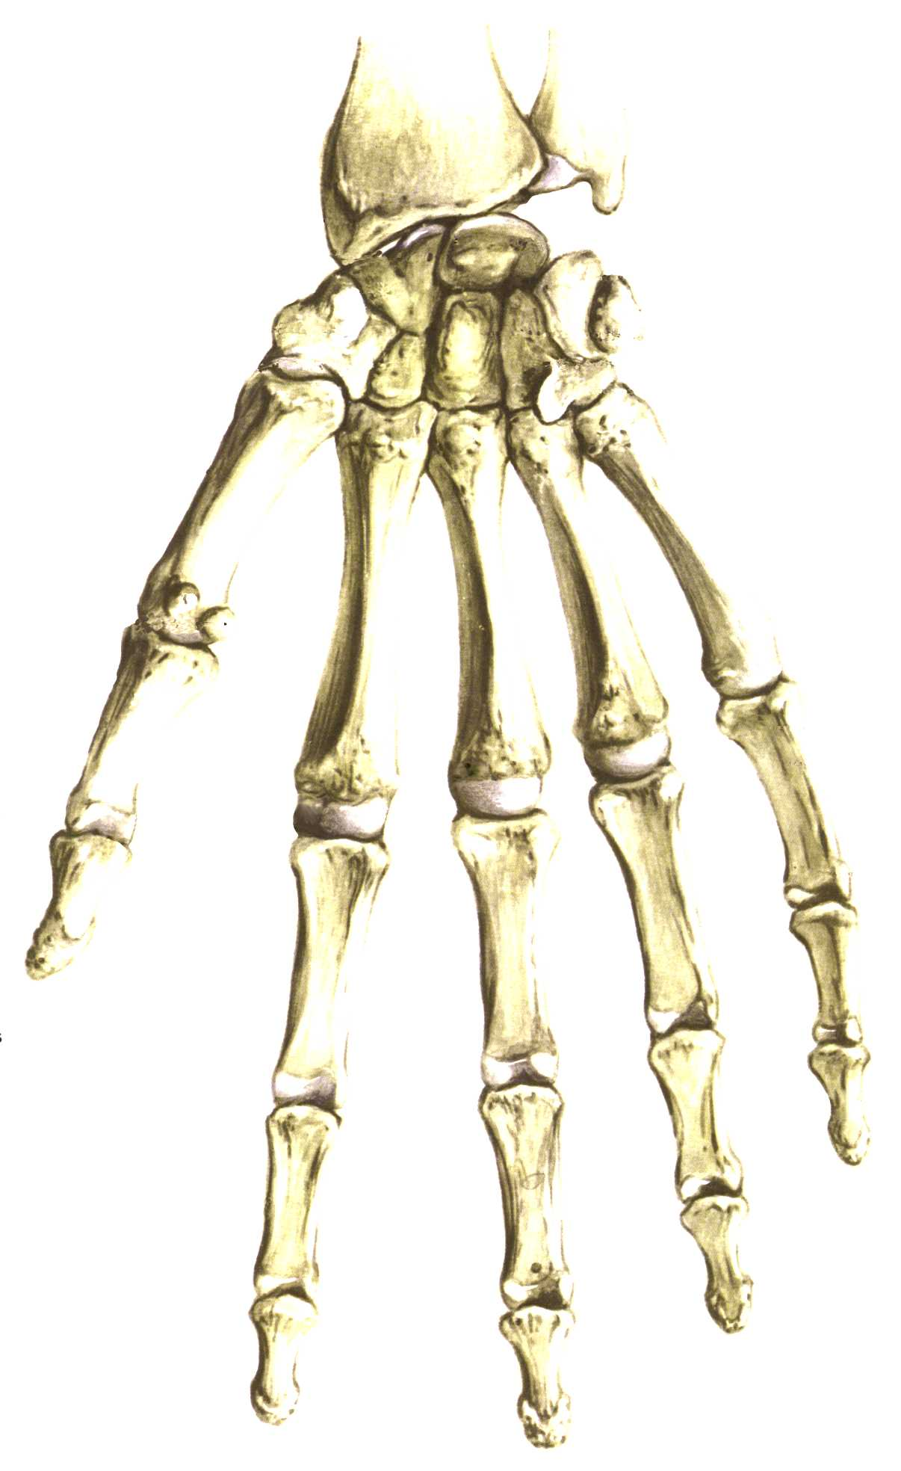
The Upper Limb (Continued)
Carpals
Proximal Phalanges
1
5
Métacarpals
2
3
4
Phalanges
Middle Phalanges
Distal Phalanges

Slide 6
The Carpus (Wrist)
The carpus is formed by two rows of four bones per row called carpals.
Scaphoid
Lunate
Triquetral
Pisiform
Trapesium
Trapezoid
Capitate
Hamate
The acronym representing the carpals from lateral to medial:
She Likes To Play, Try To Catch Her

Slide 7
