Slide 1
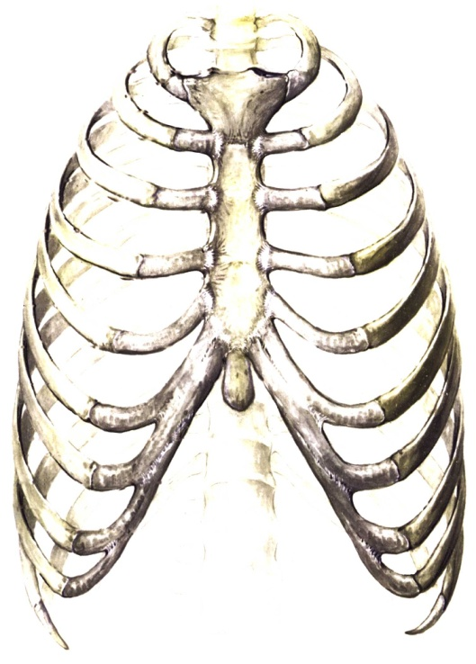
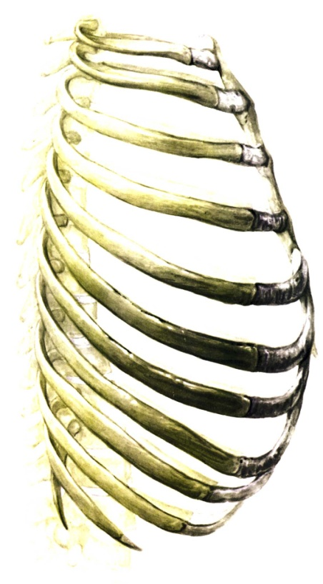
The Skeletal System
The Ribs and Sternum
Cartiage
12 Pairs of ribs consisting of:
flat bones
cartilage
give strength to the chest
and permits it to expand
** The ribs are curved and slightly
twisted making them ideal to
protect the chest area
Flat bone

Slide 2
The Ribs
All 12 ribs articulate with the 12 thoracic vertebrae posteriorly.
These ribs are divided into 3 parts:
The true ribs:
Ribs 1 to 7 (Upper 7 pairs)
Attaching both to the sternum and the vertebrae
The false ribs:
Ribs 8 to 10 (3 pairs)
Attaching to the sternum indirectly
The floating ribs
Ribs 11 and 12 (2 pairs)
Only attach to the vertebrae

Slide 3
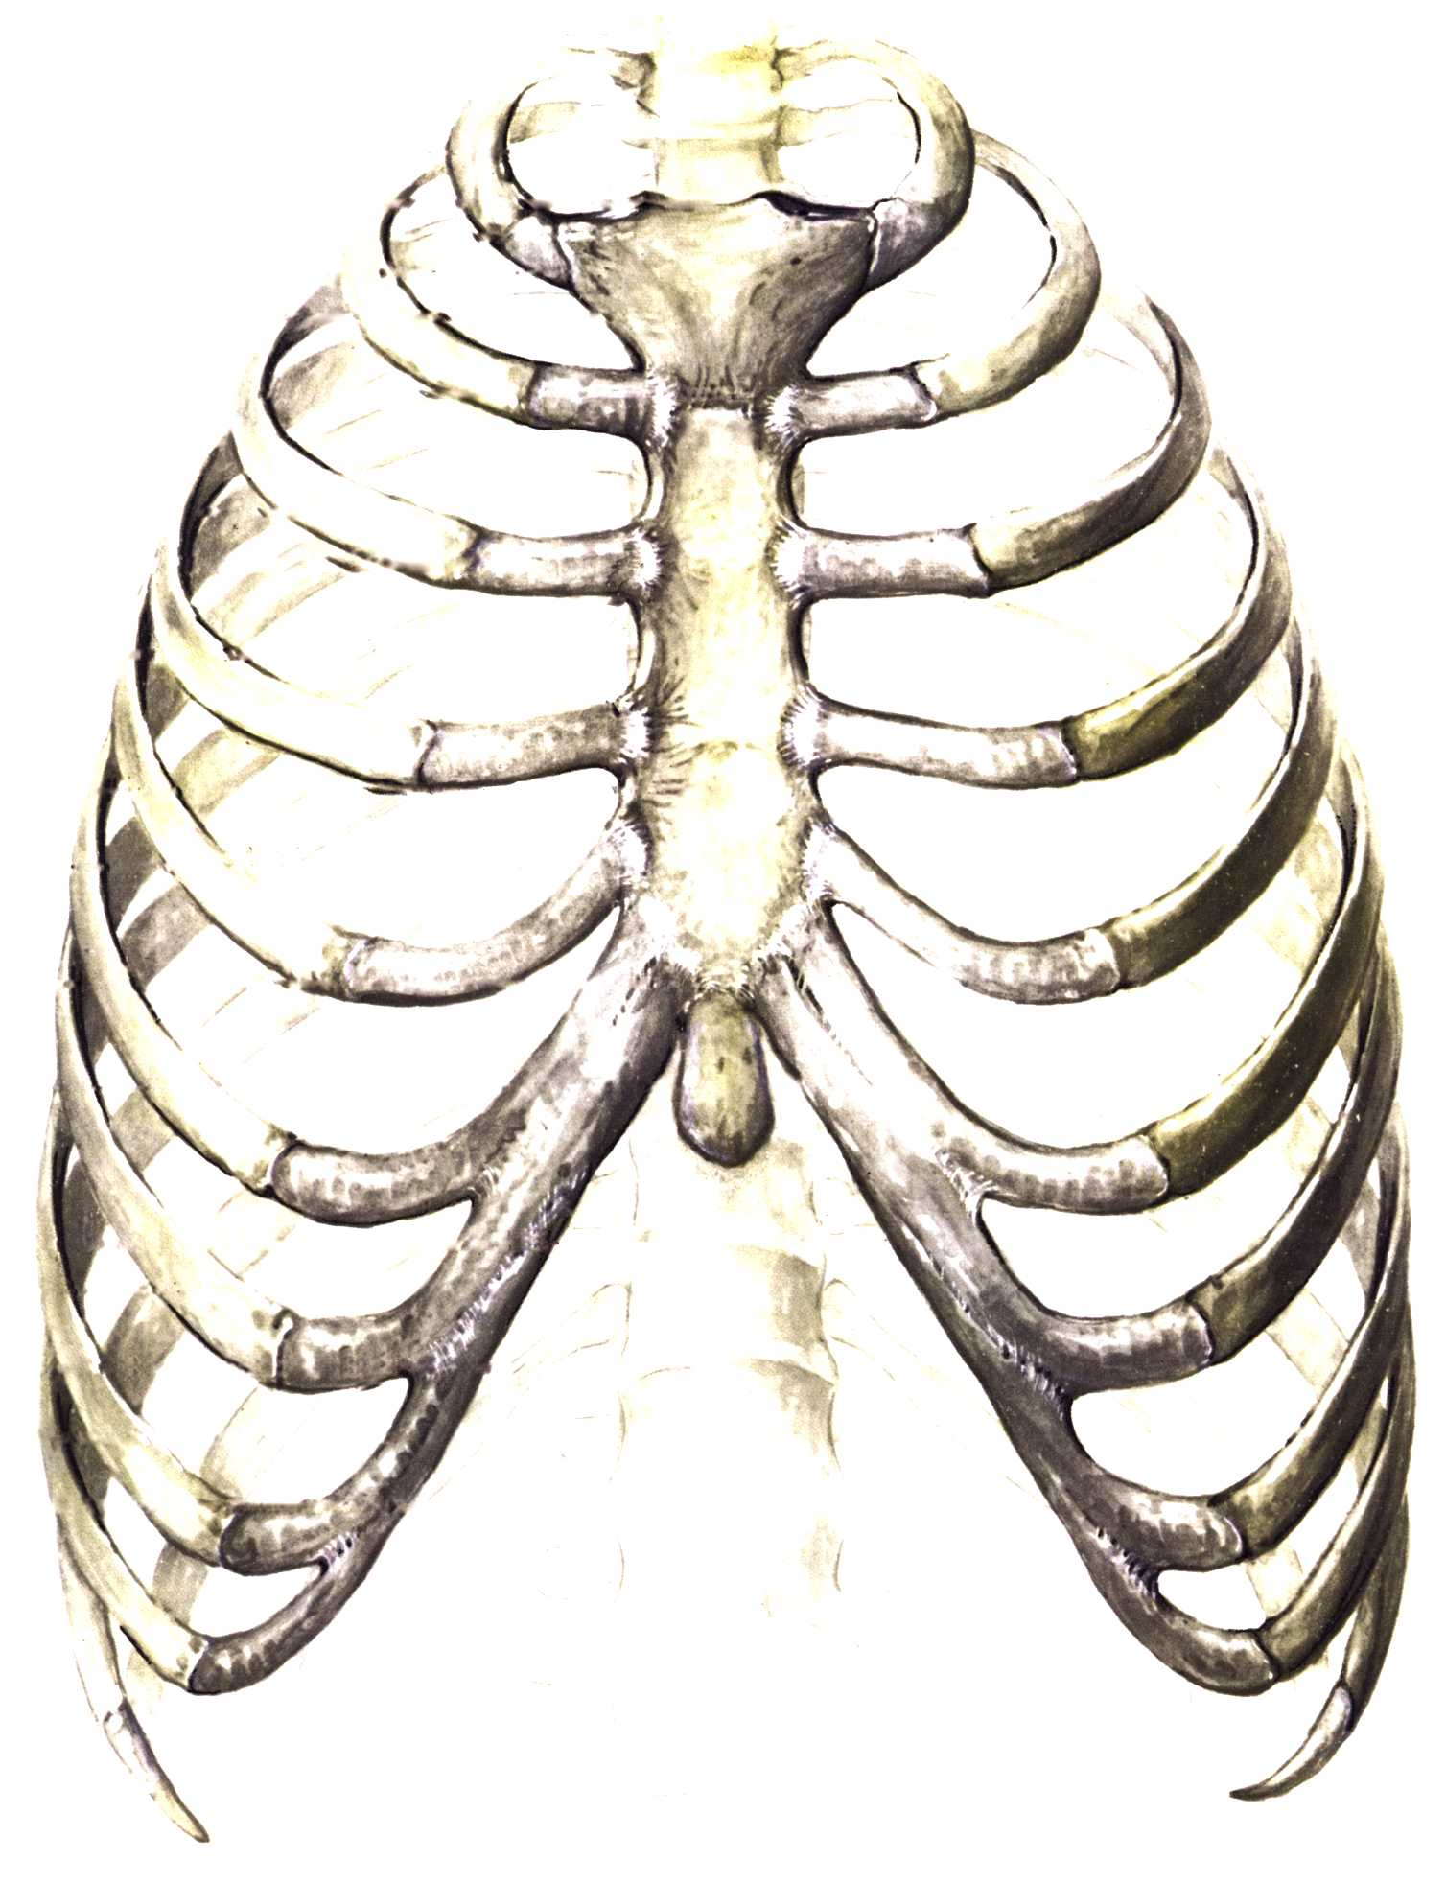
The Ribs
Manubrium
Sternum
True Ribs
(1-7)
Xiphoid Process
False Ribs
(8 – 10)
Costal Cartilages
Floating Ribs
(11 – 12)

Slide 4
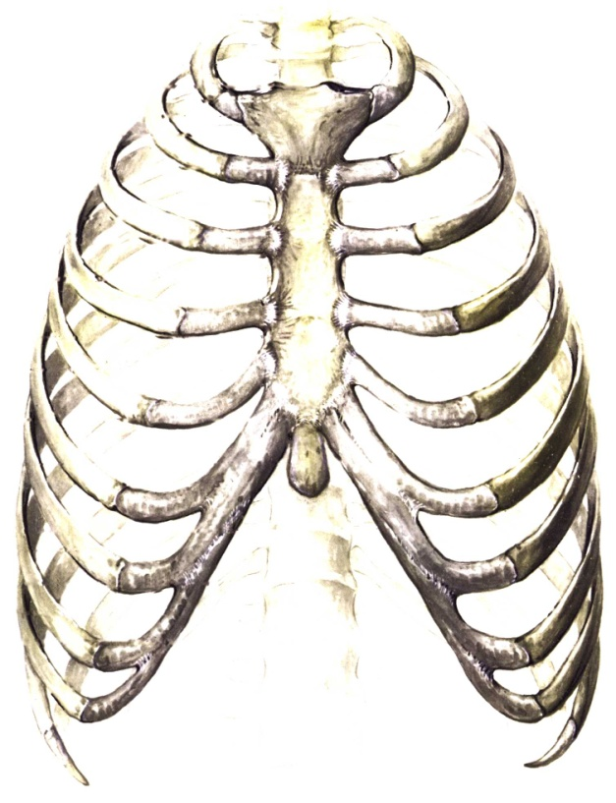
Sternum
Central bone of the chest
The clavicle and ribs 1 to 7 articulate with the sternum.
Sternum – comprised of the manubrium, the sternum bodyand the xiphoid process

